Slide 1
The PMRC Effects on Music Popularity

Slide 2
Outline
Hypothesis
The Data
Cool Graphs / Analysis
Conclusions

Slide 3
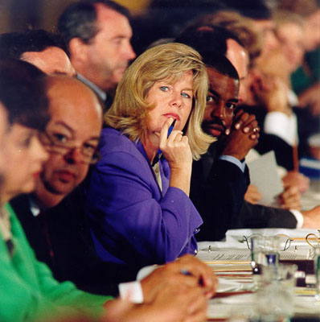
Hypothesis
Hypothesis
In the 1985, the Parents Music Resource Center (PMRC) pushed to put a warning label on 'explicit' music
This was supposed to help parents monitor the music their children were buying
I propose albums and music with explicit lyrics and images were more popular after the mid to late 1980's because of the ‘explicit’ labels.
Notes:
In the mid to late 1980's, there was a big push to put a warning label on records and CD's that were deemed 'explicit' and had suggestive or 'satanic' lyrics. This was supposed to help parents monitor the music their children were buying. I propose it had the opposite effect. Albums and music with explicit lyrics and images were more popular after the mid to late 1980's.

Slide 4
The Data
Weekly Hot 100 singles chart between 1958 and 2019, over 300,000 records
Spotify, including song genres and an ‘explicit’ indicator, over 25,000 records
I merged these 2 files together for my analysis
I only used the top 75 songs to make the data manageable, about 14,000 records
Raw data available here

Slide 5
Assumptions
The music genre list by Spotify is accurate
Popularity determines total sales
Higher ranking in top 100 means higher total sales
Notes:
My determination of a single genre for each song is accurate

Slide 6
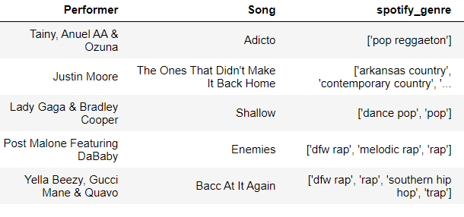
Example genre lists for individual songs:
I picked one genre out of each genre list: rap, hip-hop, pop, country or metal
Notes:
My determination of a single genre for each song is accurate

Slide 7
Cool Graphs

Slide 8
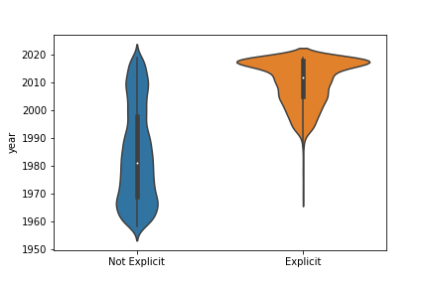


There were very few 'explicit' songs before 1985
vs.

Slide 9
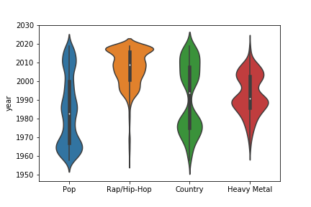




Rap and hip-hop became popular right after the PMRC was formed in 1985

Slide 10
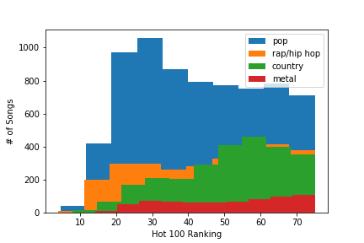
No significant difference in Hot 100 ranking between genres

Slide 11
Analysis Details
Hot 100 lists - With 95% confidence, the popularity of rap, hip-hop and metal music increased dramatically after 1985, while pop and country stayed relatively steady
Spotify - With 95% confidence, explicit music as defined by Spotify became significantly more popular after 1985

Slide 12
Conclusions
Explicit music became significantly more popular after the PMRC was formed in 1985
Rap and Hip-Hop are more explicit on average than other types of music
Because explicit music is more popular after 1985, sales of explicit music have significantly increased since then

Slide 13
Questions?

